Slide 1


Regression Methods in Machine Learning Simple Linear Regression
Artificial Intelligence Training
Andrew Ferlitsch Instructor
July, 2017

Slide 2
Linear Regression
Used to Predict a correlation between one or more independent variables and a dependent variable. e.g., Speeding is correlated with Traffic Deaths
When the data is plotted on a graph, there appears to be a straight line relationship.
Y (Dependent Variable)
Line
X (Independent Variable)

Slide 3
(Simple) Linear Regression
Used to Predict a correlation between a single independent variable and a dependent variable.
Find a linear approximate (line) relationship between
independent variable (usually referred to as x), and
the dependent variable (usually referred to as y).
In Machine Learning, x is referred to as the feature,
and y is referred to as the label.

Slide 4
(Simple) Linear Regression by Many Names
Elementary Geometry: Definition of a Line
y = mx + b
Linear Algebra
y = a + bx
Machine Learning
y = b₀ + b₁x₁
y intercept or bias,
Where the line crosses the y-axis
slope, weight
or coefficient

Slide 5
(Simple) Linear Regression
It’s In The Line
Label
(learn)
Data Plotted (Scatter)
Spend
(y)
Best Fitted Line
bx (slope)
a
0
Age
(x)
Feature (data)
y = a + bx

Slide 6
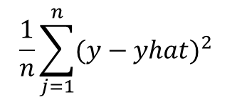
Loss Function
Minimize Loss (Estimated Error) when Fitting a Line
y2
Actual Values (y)
y4
(y – yhat)
y1
y6
y5
Predicted Values (yhat)
y3
Sum the Square of the Difference
$$\frac{1}{n}\sum_{j=1}^{n}{{(y−yhat)}^{2}}$$
Mean Square Error
MSE =
Divide by the number of samples

Slide 7
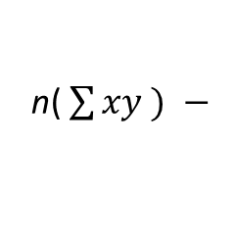
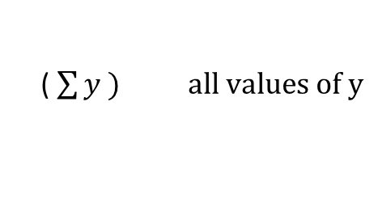
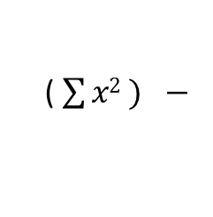
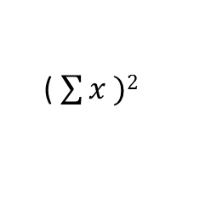
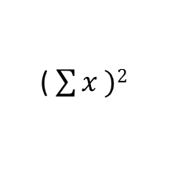
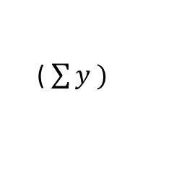
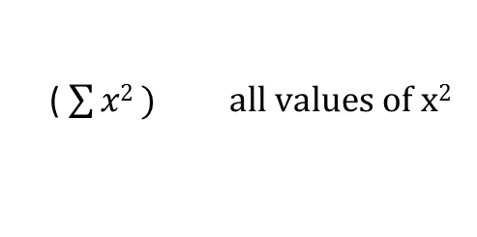
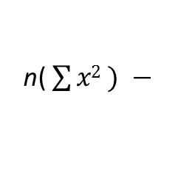
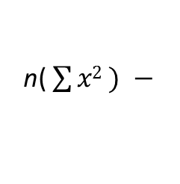
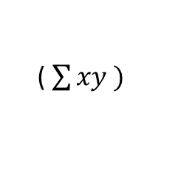

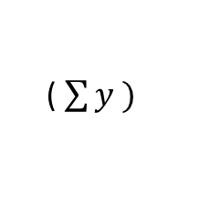
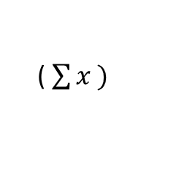
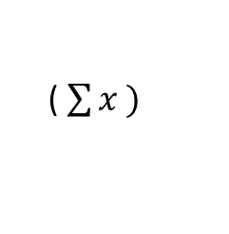
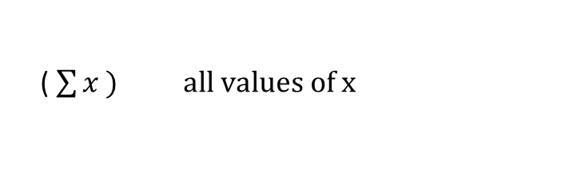
Solving Simple Linear Equation
Solution to the Equation can be Computed
( $\sum{y )}$
( $\sum{x2 ) −}$
( $\sum{x )}$
( $\sum{xy )}$
a =
n( $\sum{x2 ) − }$
( $\sum{x )2}$
n( $\sum{xy ) −}$
( $\sum{x )}$
( $\sum{y )}$
b =
n( $\sum{x2 ) − }$
( $\sum{x )2}$
Solve the following summations, and then easy to compute:
( $\sum{x )} all values of x$
( $\sum{y ) all values of y}$
( $\sum{xy ) all values of x∗y pairs}$
( $\sum{x2 ) all values of x2 }$

Slide 8
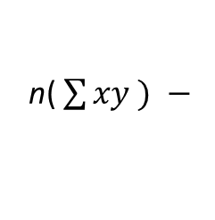
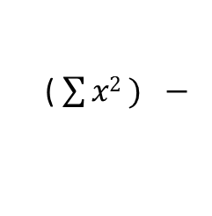
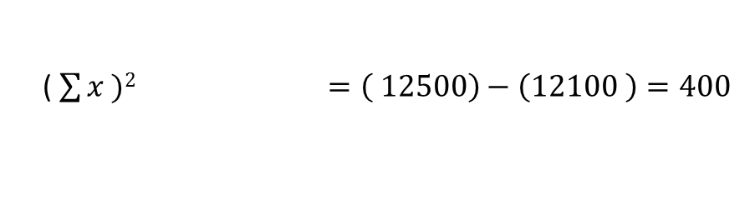
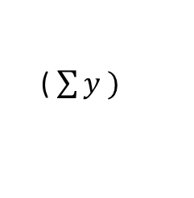
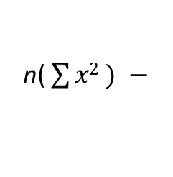
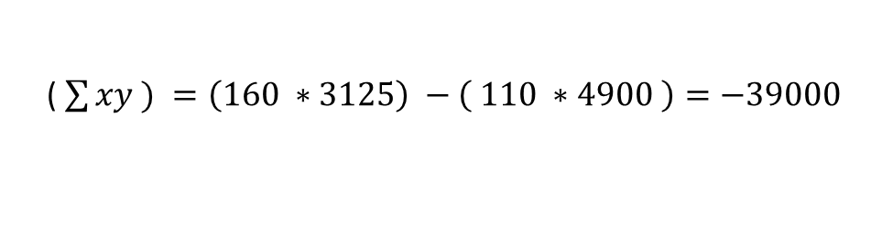
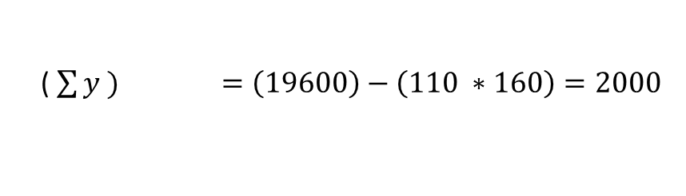
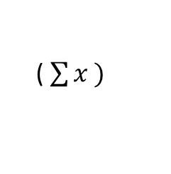
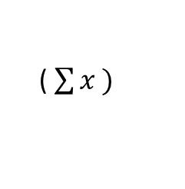
(Simple) Linear Regression Example
Spreadsheet (Excel) Process for Computing Simple Linear Regression
Raw Data
Computed Values
 | Age (X) | Spending (Y) | X² | XY
 | 20 | 10 | 400 | 200
 | 25 | 30 | 625 | 750
 | 30 | 50 | 900 | 1500
 | 35 | 70 | 1225 | 2450
∑ | 110 | 160 | 3125 | 4900
Summations
( $\sum{y )}$
( $\sum{x2 ) −}$
( $\sum{x )}$
( $\sum{xy ) =\left(160 ∗3125\right) −\left( 110 ∗4900 \right)=−39000}$
n( $\sum{xy ) −}$
( $\sum{x )}$
( $\sum{y ) =\left(19600\right)−\left(110 ∗160\right)=2000}$
n( $\sum{x2 ) − }$
( $\sum{x )2 =\left( 12500\right)−\left(12100 \right)=400 }$
a = -39000 / 400 = -97.5
b = 2000 / 400 = 5

